Slide 1
Woodland Public Schools
Facilities and Safety Report
For September 2019

Slide 2
FACILITIES REPORT
Automated Lockdown Announcement – Over the next couple of weeks we will be looking into automating the lockdown announcement at all schools. This will be accomplished by creating a prerecorded message (much like Humoctopus) in the Informacast program and tying it to all of the schools lockdown hardware. This will give the offices the ability to quickly get the buildings into Lockdown (flip of a switch) without having to use the paging system should the need arise.
Yale School Fencing The current fencing at the Yale School only parallels along the road (Lewis River Rd.) and terminates to the building on the east end near the entry door. We will be extending this fence on the west and north side of the sports field, so it covers 360 degrees. This will keep the occasional loitering cows and other animals from entering this area of the school.
Upcoming Halloween No Student Days Facilities will take advantage of the time to complete some maintenance activities including:
Moving and anchoring equipment in the WHS auto shop
Installing a commercial water heater above the commons at WMS
Resurfacing the floor in the WMS kitchen
Elevator fire and recall test (NFE and WHS)
Repair section of sprinkler piping in CES
Repair section of sprinkler piping WMS
Adding locking hardware to NFE classroom doors

Slide 3
FACILITIES REPORT
Reunification Drill March 2020 - We are planning to run a reunification drill in the spring to test our reunification program. The plan will be to reunify a group of students (approximately 75) from WMS to WHS gym. We will set up the reunification point at the entrance to the WHS gym. The goal of this is to test the following programs in the event of an actual emergency.
Deploy busing to the school in sufficient numbers
Check reunification policy/procedure/strategies
Set up of the reunification point
Coordination of the police and first responders
Reunification equipment checks
Traffic control
Over the next few months, we will be honing our skills and training in these areas. More information to follow…
SOP and Policy Revisions- Completed annual update of the district’s Emergency Operations Plan (procedure 3432) and completed an edit to Pesticide Notification Policy (6895) and the associated procedure.
Urgent Repair Grant 909 - I have applied for the Urgent Repair Grant for two areas of WMS. The first is to replace all of the gutters and downspouts on the two main buildings of the middle school (1930 linear feet) and the second replaces the water piping main from Park Street to the Green Gym, Auditorium and Wood/Metal Shops.

Slide 4
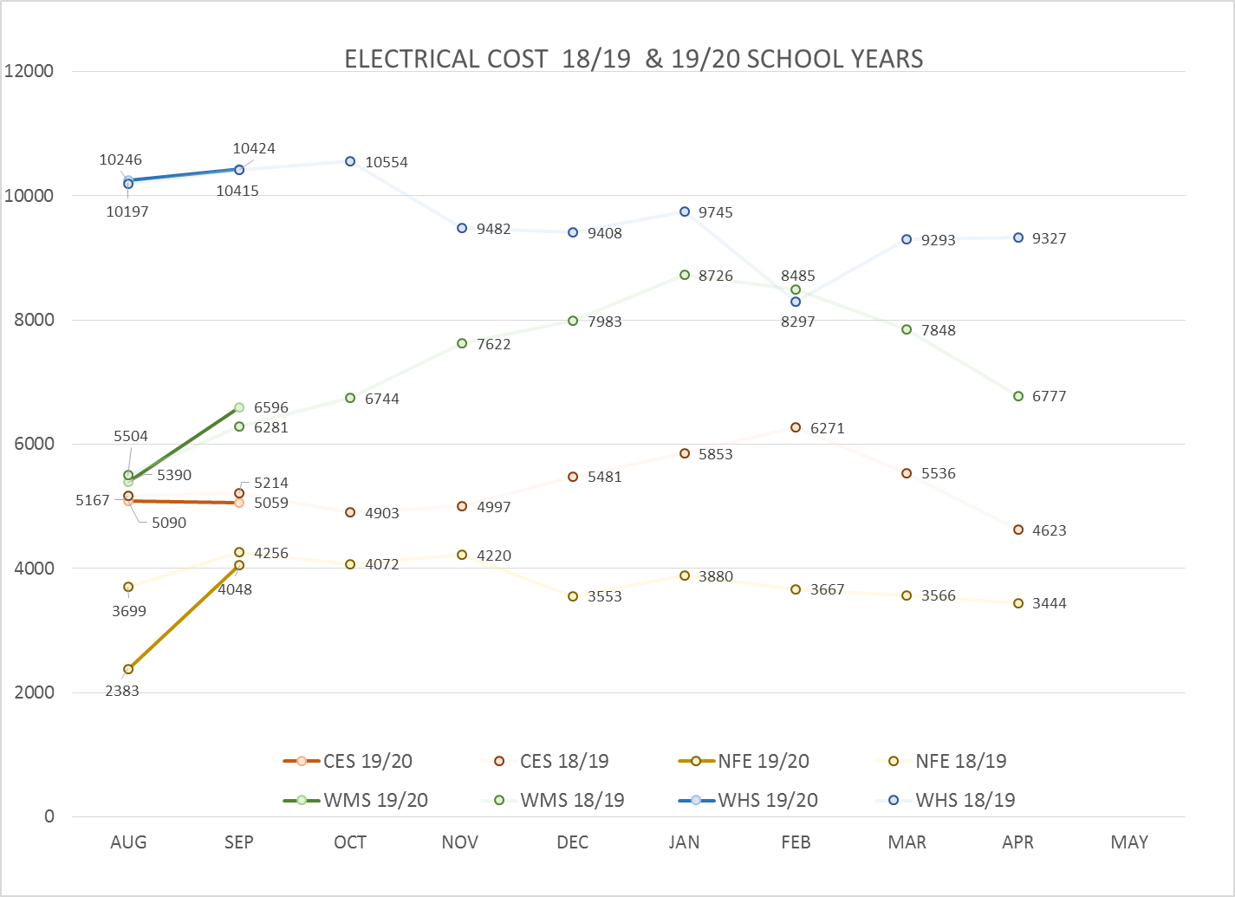
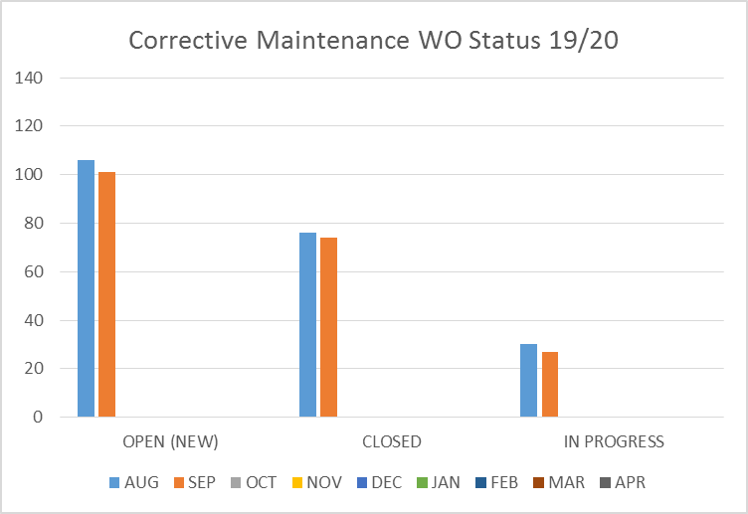
FACILITY CHARTS – POWER COST AND WORK ORDER STATUS

Slide 5
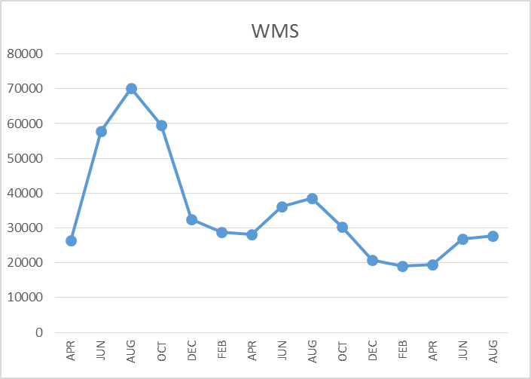
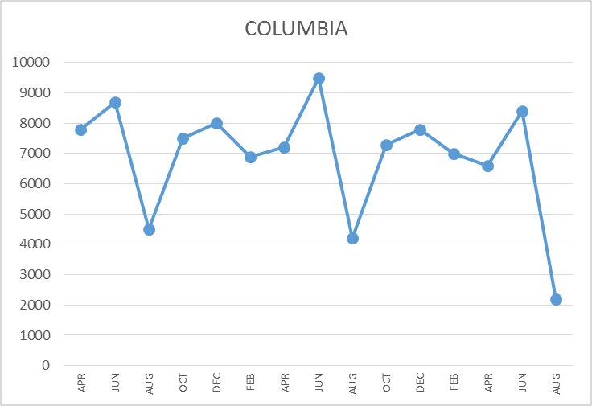
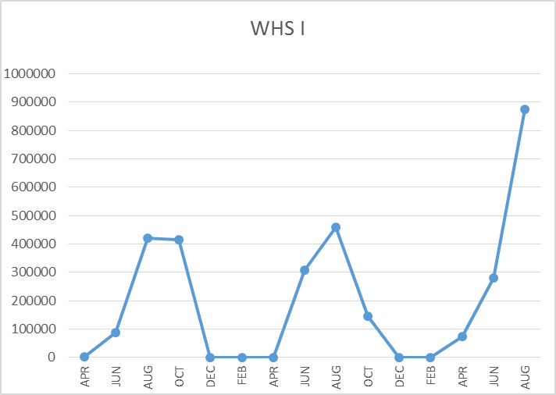
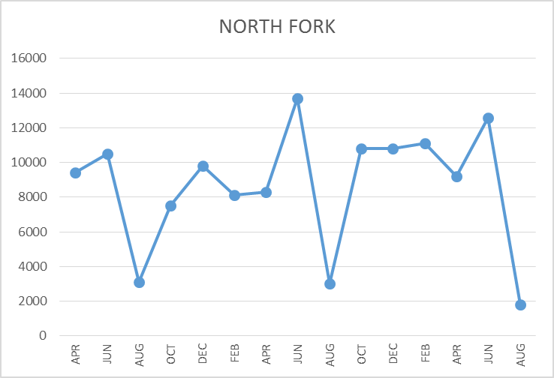
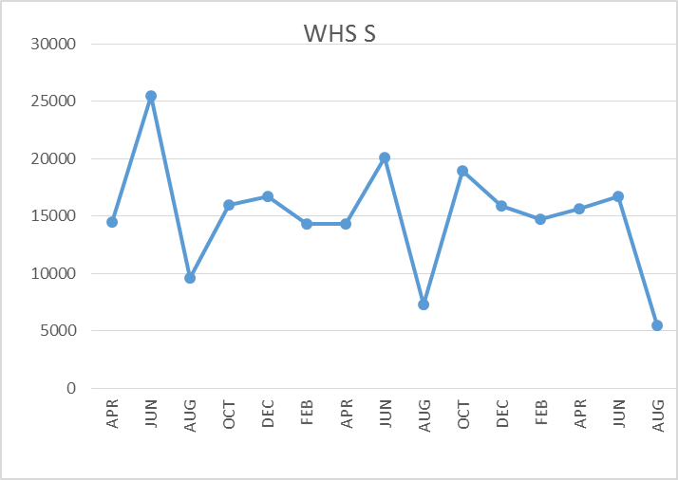
FACILITY CHARTS – WATER USAGE WHS, NFE, WMS, CES
Note
Water charts are updated every two
months. Next update to these charts
in November 2019.
The WHS irrigation system
had underground leak. Billing
was adjusted from
$24,844 to $9690.(representing historical usage)
The WMS chart has been reconfigured to include the following 7 meters: 755 Park high and low flow, BO and Team High, PIT house, bus barn, athletic field and DO. All of these meters are totaled on the WMS graph, but each data point is recorded separately to aid in identifying leaks.

Slide 6
Safety Summary
Staff Accidents/Incidents
(No data available)
Student Accidents/Injuries (11)
CES – Fell on play structure, fractured arm
CES – Hit in hand with ball, sprained wrist
CES – Tried to sit in walker, lost balance and tipped backward, emotionally upset , no injury noted
WMS – Football soft tissue injury to leg
WMS – Soccer finger injury
WMS – Knee injury during soccer practice when standing up
WHS – Football knee injury sprain
WHS- Sprayed brake cleaner in eye, sent to urgent care
WHS – Hit back of head during soccer, concussion screen complete, went to ER cleared by doctor
WHS – Touched hot saw blade, minor burn to finger
WHS – Strained back during soccer practice

Slide 7
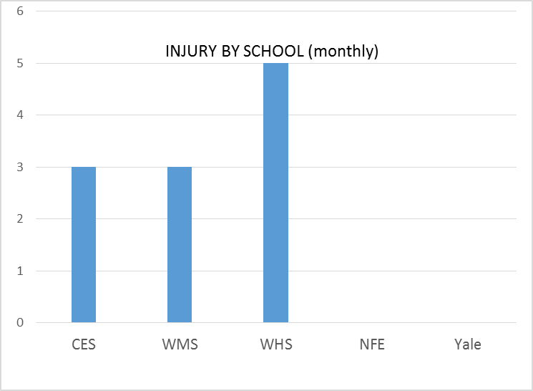
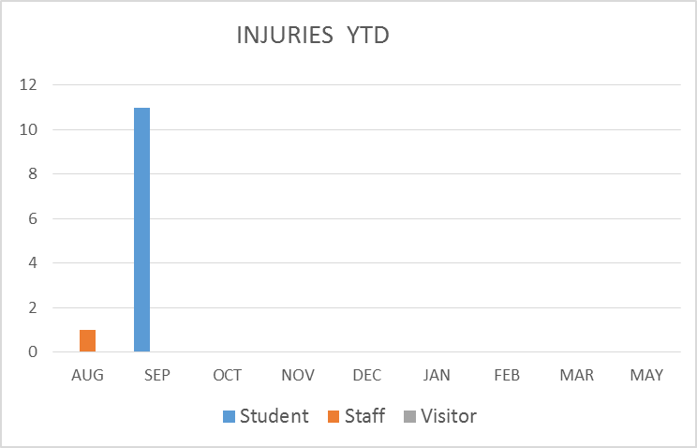
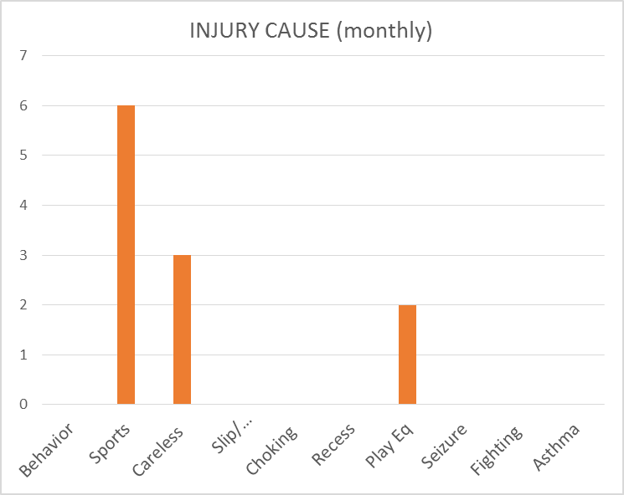
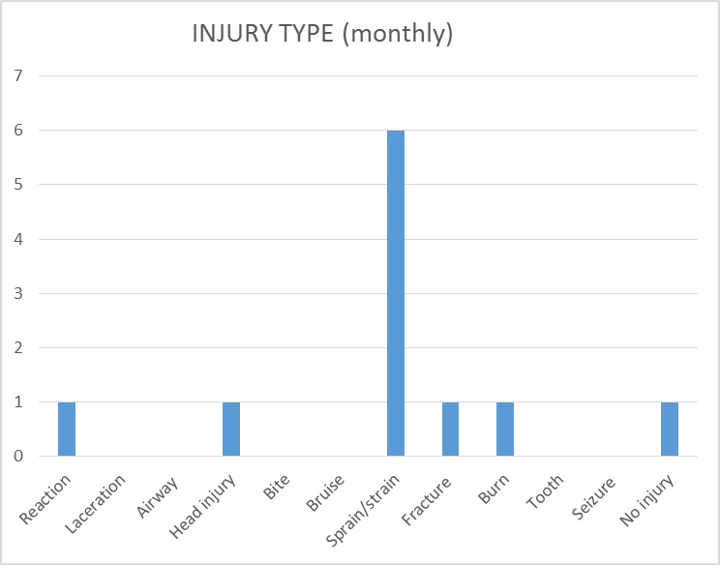
SAFETY CHARTS

